Slide 1
Air Force Officer Training Program
US Air Force and US Space Force Commissioning Source

Slide 2

The AFROTC experience

Slide 3
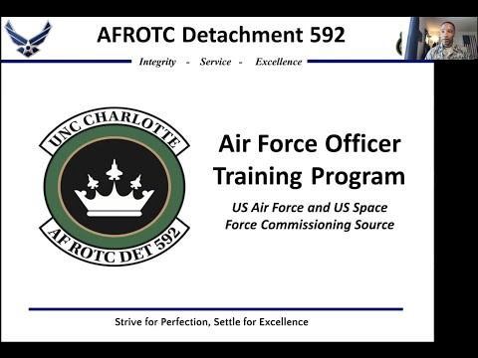

Slide 4

Overview

Slide 5
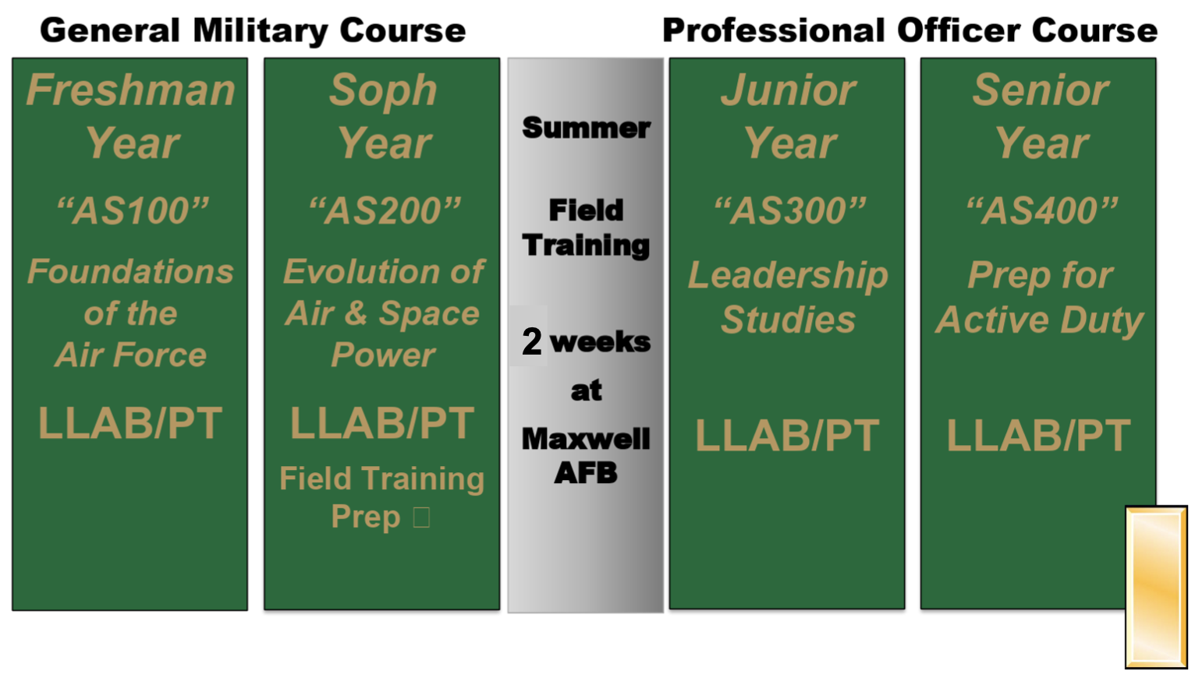
Overview

Slide 6
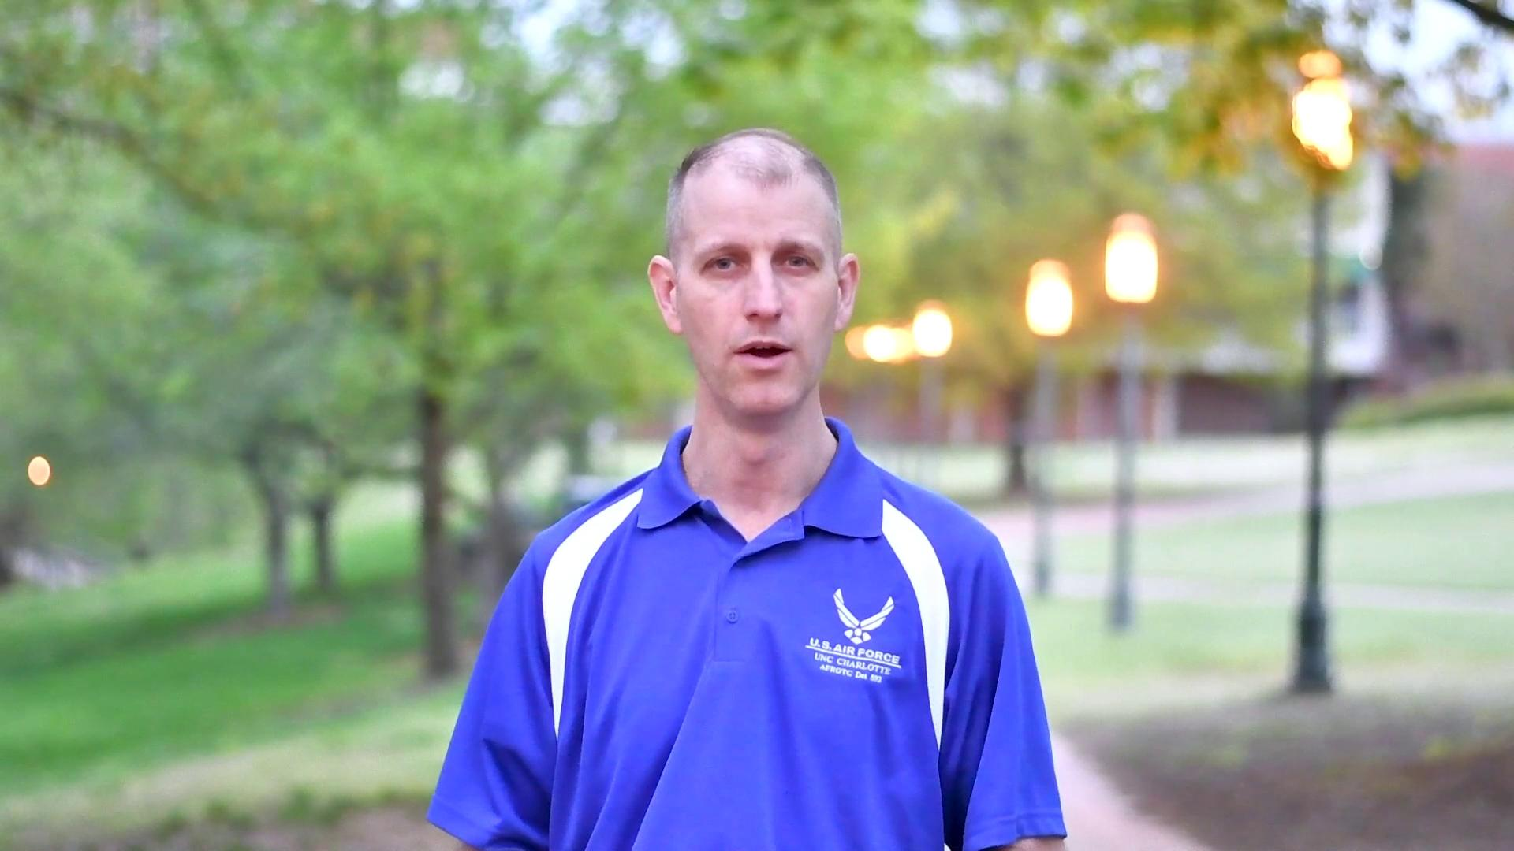
Who We Are

Slide 7

How to Join
Register for AERO 1101 and AERO 1100
Attend New Cadet Orientation
Be eager to learn skills applicable in a variety of situations and environments
No commitment is required to join

Slide 8
Frequently Asked Questions
Is military or JROTC experience required to Join?
  No military or JROTC experience is necessary to join, many cadets have no prior military experience
Will I receive a scholarship?
  While there are scholarship opportunities, many participants are not on scholarship
Am I committed to service once I join?
  No service commitment is required upon entering the program
Will I get a job from Air Force ROTC?
  Contracts are usually signed 2 years before graduation, providing a secure job upon program completion

Slide 9
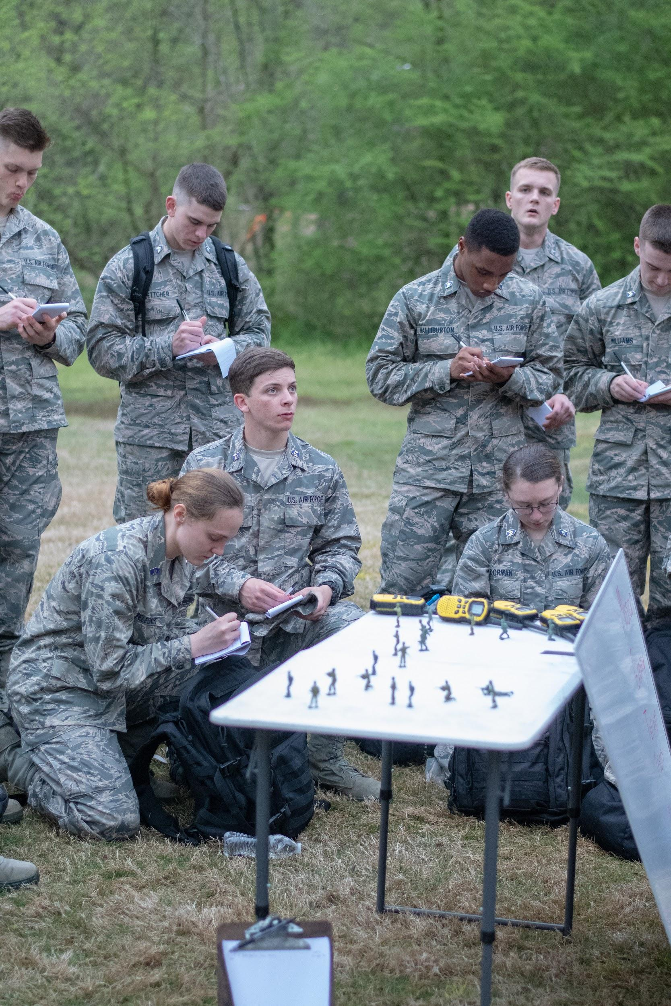
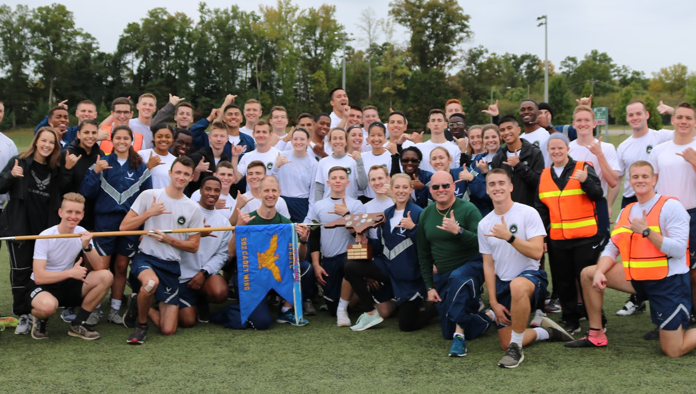
Want to Know More?
Website
  afrotc.uncc.edu
Contact a cadet here
Follow Us!
Instagram: @det592
Facebook: @det592
YouTube: AFROTC Det592

